Slide 1
Introduction to Game Programming

Slide 2
Objectives
Get some ideas on video game industry
  History, status
  Game genre
  Development cycle
  Roles in game company

Slide 3
Video game history

Slide 4
Video game history
Before SpaceWar (1962)
  The video game industry didn't begin as part of any established master plan
  1951 – Nintendo (leave luck to Heaven)
  1946 – Sony (sonus = sound in Latin)
  William Higinbotham - nuclear physicist at Brookhaven National Labs in New York – Tenis for two
  1951 Ralph Baer – proposed first home console concept
Notes:
History of Video Games : 1947 – 1979: https://www.youtube.com/watch?v=dF0vS5ZrMiI
Nintendo (leave luck to Heaven): Founded on September 23, 1889,^{[2]} by Fusajiro Yamauchi, it originally produced handmade hanafuda playing cards, Based in Kyoto, Japan, the business produced and marketed a playing card game called "Hanafuda“. The word Nintendo can be roughly translated from Japanese to English as "leave luck to heaven".
http://kotaku.com/5649625/nintendo-might-not-mean-what-you-think : The History of Nintendo argues that "Nintendo" (任天堂) could then mean "the temple of free hanafuda" or "the company that is allowed to make (or sell) hanafuda"

Slide 5
Video game history
SpaceWar to Atari
  By Steve Russell, MIT student in 1961
    True game play
      Competition between two peers
      Rules of action
      A clear victory condition
  Nolan Bushnell found Atari in 1972
    Pong on coin-op machines (arcade)
  Ralph Baer in 1972
    First game console - Magnavox Odyssey
Notes:
SpaceWar :
Developer(s) Steve Russell
Publisher(s) Steve Russell
Platform(s) PDP-1
Release date(s) NA: 1962
Genre(s) Space combat
Mode(s) Multiplayer
The original Atari, Inc. founded in 1972 by Nolan Bushnell and Ted Dabney was a pioneer in arcade games, home video game consoles, and home computers. The company's products, such as Pong and the Atari 2600, helped define the electronic entertainment industry from the 1970s to the mid-1980s.

Slide 6
Video game history
Game Consoles and Personal Computers
  Console manufacturers and game developers relationships
  1977 - Atari 2600 ($249)
    6507 CPU with 128 bytes RAM built-in
    Program is on external cartridge (6KB ROM)
  1977 – Apple II
    6502 CPU
    16KB RAM (up to 48KB RAM)
    280x192 screen with 16 colors

Slide 7
Video game history
Shakedown and Consolidation
  1970s – 1980s: golden age
  Bad game qualities – video game industry crashed.
  1985 – NES by Nintendo with high-quality in-house games.
  VGA with 256 colors
    Day of the Tentacle (Lucart Arts)
    Alone in the Dark
Notes:
Shakedown and Consolidation : Ra soat va cung co

Slide 8
Video game history
The Advent of the Game Engine
  1993 - Doom engine by id Software (Wolfenstein, Doom, Hexen)
  Scripting & core engine
  Toolset for game content (Gmax and Maya Personal Edition)

Slide 9
Video game history
The Handheld Revolution
  1989 – Nintendo Game Boy
    the most successful game product
    longest life cycle (11 years)
  1998 – Game Boy Color
  2000 – Game Boy Advance (GBA)

Slide 10
Video game history
The Cellular Phenomenon
  From 2000 - Java apps for phones
  NTT DoCoMo’s I-Mode service in 1999 in Japan
    Monthly fee to download mobile content
    Until April 2002, 32M subscribers (28,000 new users per day)
  Smartphones: iPhone, Android
  Tablets: iPad
Notes:
The Cellular Phenomenon : hien tuong dien thoai

Slide 11
Video game history
Online Games
  1979 - Essex MUD (text-based game)
  1990s – Everquest (graphical multiplayer game)
  MMORPG: Massive Multiplayer Online Role Playing Game
  November 2004 - World of Warcraft by Blizzard Entertainment
    the most successful multiplayer game world-wide
    On January 2008: >10M subscribers
      2M in Europe
      2.5M in North America
      5.5M Asia

Slide 12
Video game history
SNS Games – games on Social Network
  FaceBook (ZingMe, Soha)
  Social game giant : Zynga
    In 5 years : from 0 to 9 billions dollars
    Hit tittles : FarmVille, CityVille
      61 monthly active users
      16 daily active uses

Slide 13
Game development team

Slide 14
Game Development Team
Vision
  Understand how technical issues affect and constrain the project (developer)
  Understand art-related tasks (artist)
  Understand what is a fun game (designer)
  “People person” to pull all persons toward a common goal.
  Internal compass, gate keeper
  Have a firm understanding of the core elements that will make the game successful

Slide 15
Game Development Team
Production team
  Project manager, project lead, director
  A bridge between business & development.
    Explain the game to business PR, marketing, sales
    Update business team on development status
    Update dev team on business activities
    Make sure dev team has needed resources
  Risk management
    Foresee bad things
    Prevent them from happening
    Proactively deal with them to minimize its damages (contingency plan)

Slide 16
Game Development Team
External Producer
  A publisher’s employee to “watch” the external development
Internal Producer
  A developer’s employee to “report” the publisher or the investor.
The Assistant and Associate Producers
  Detail tasks

Slide 17
Game Development Team
Design team
  Make sure people “play” the game before it has been created.
  Make the game fun
Game Designer
  “Explain” how to play the game
  Filter game ideas against the vision
  Understand games!

Slide 18
Game Development Team
Level designer
  Create game content: scenes, levels, stories, quests,…following common vision
  Who responsible for every single fun moment of the game!
  Level design sucks => game sucks

Slide 19
Game Development Team
Writer
  Responsible for text in the game
    Character dialog
    Cut scene narratives
    Sports commentary
    Journals
    Manuals

Slide 20
Game Development Team
Programming
  Build it! Materialize it!
Tech lead
  Work with producer, designer, art for requirements
  Plan for resources, tasks
  Foresee technical issues how to deal with them
Programmer
  The true worker! ☺

Slide 21
Game Development Team
Art
  Make the game looks nice, make it sells!
Art lead
  Plan for resources, tasks
  Style guide (bible)
Artist
  Concept: draw what is in the designer’s head
  Character modeling
  Animation
  Background modeling
  Texture

Slide 22
Game Development Team
Test
  Make sure it runs and it is fun
Test lead
  Plan for resources, tasks (test plan)
Testers
  Game players

Slide 23
Game development life cycle

Slide 24
Game Development Life Cycle
Concept development
  What is the game?
  Major gameplay element
  Concept arts
High concept
  One or two sentence description of what the game is about
    A busty female archaeologist pursues ancient treasure. (Tomb Raider)
    An ordinary technician battles transdimensional monsters after an accident at a secret research facility.

Slide 25
Game Development Life Cycle
Concept development
  What is the game?
  Major gameplay element
  Concept arts
High concept
  One or two sentence description of what the game is about
    A busty female archaeologist pursues ancient treasure. (Tomb Raider)
    An ordinary technician battles transdimensional monsters after an accident at a secret research facility.

Slide 26
Game Development Life Cycle
Game proposal (pitch doc)
  Two page doc to present to investors or publisher
  What is the game and how it can earn money?
Concept doc
  More detail version of the pitch doc
  Give to publisher for them to read later (usually by the publishing team)

Slide 27
Game Development Life Cycle
Concept doc (con’t)
  High concept
  Genre
  Gameplay
  Features
    What make the game unique (or special)?
  Setting
    The game world (universe)

Slide 28
Game Development Life Cycle
Concept doc (con’t)
  Story
  Target audience
  Hardware platform
  Estimated Schedule, Budget, and P&L
  Competitive Analysis
  Summary

Slide 29
Game Development Life Cycle
Preproduction (Proof of Concept)
  Prove that you can make the game!
  Prototype
Game design document
  Very long => use Wiki, WordPress instead
Art production plan
  The Art Bible (style)
  Production path: how to go from concept to reality
  Assets, Budgets, Task, and Schedules

Slide 30
Game Development Life Cycle
Technical Design Document
  How to convert paper into code
  Planning, tools, resources, hardware, software, …
Project plan
  Overall plan on how to build the game
  Manpower plan
  Resource plan
  Project tracking doc
  Budget: how much money?
  P&L

Slide 31
Game Development Life Cycle
Project plan (con’t)
  Development plan
  Milestone definitions
Game prototype
  The result of Pre-production phase
  Show publisher that this is a great game within one or two minutes

Slide 32
Game Development Life Cycle
Development
Alpha
  Almost completed game (core features), game is playable
Beta
  Bug fixing only
  Crunch time
    During these weeks, people have been known to stay in the office for days at a time, sleep under their desks, eat nothing but carryout, ingest massive amounts of caffeine, and become strangers to their families. All in all, it is a weird twilight world where the only important thing is finishing the game.

Slide 33
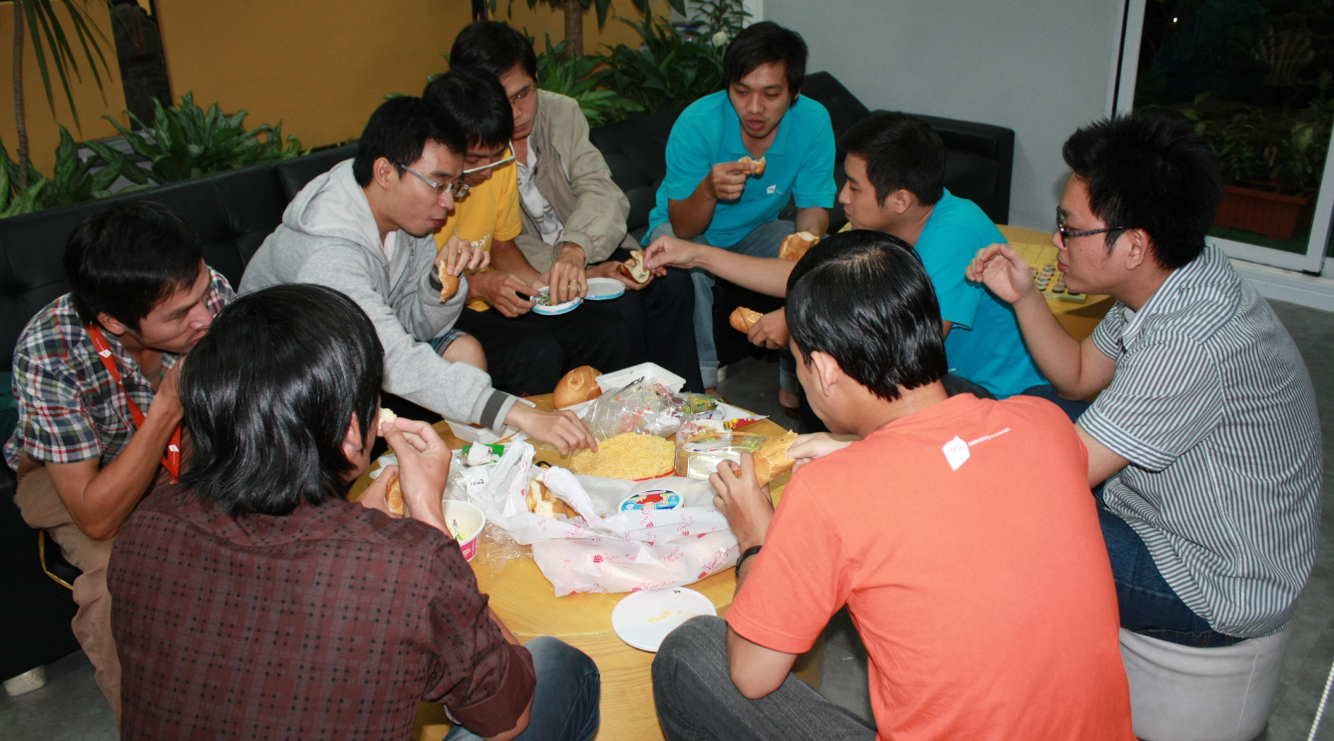

Slide 34


Slide 35


Slide 36
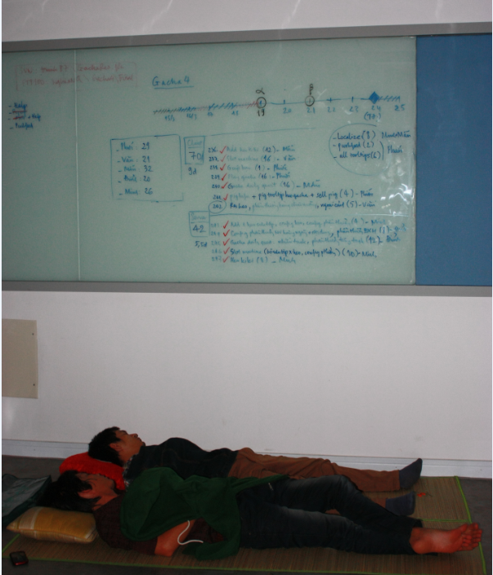

Slide 37
Game Development Life Cycle
Code freeze
  Only showstopper bugs are fixed
  Candidate master discs
RTM (Release to Manufacture)
  Celebrate! Re-discover your family!
Patches
Upgrades (expansion)
  Another project

Slide 38
SNS games ?
Game as a SERVICES
  Releasing game to public is only the beginning
  Switch to operation mode
  Continuously fix, tweak, upgrade, modify …

